Slide 1

Recurrent Neural Networks
Lei Zhang
total 55 pages

Slide 2
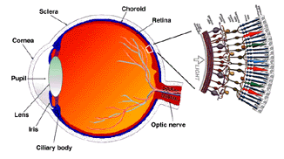
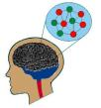
Classification of NNs
Neural Networks
Feedforward NNs
Recurrent NNs
total 55 pages

Slide 3
Feedforward NNs
total 55 pages

Slide 4
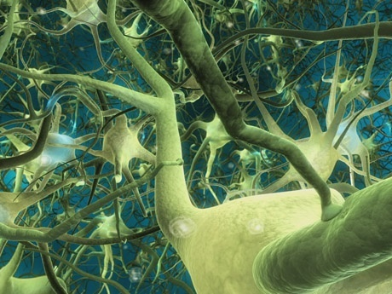
Recurrent NNs
Contain feedback among neurons
total 55 pages

Slide 5
Recurrent NNs
total 55 pages

Slide 6
Recurrent NNs
How to derive math models of RNNs?
total 55 pages

Slide 7


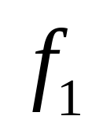
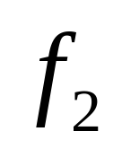








Recurrent NNs
total 55 pages

Slide 8
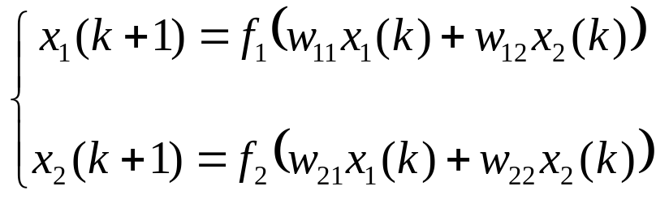




Recurrent NNs
total 55 pages

Slide 9
Recurrent NNs
total 55 pages

Slide 10
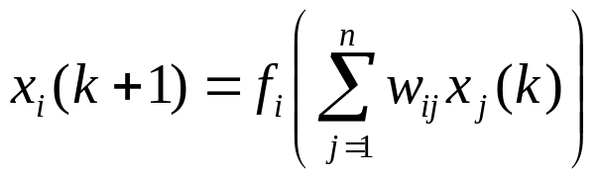
Recurrent NNs
total 55 pages

Slide 11
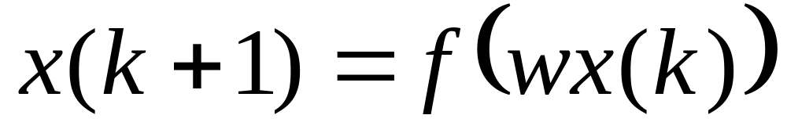
Recurrent NNs
total 55 pages

Slide 12
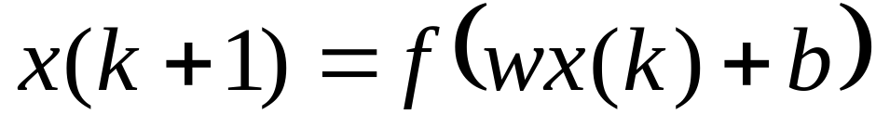
Discrete Time RNNs
total 55 pages

Slide 13










Discrete Time RNNs
Network computing
total 55 pages

Slide 14



Discrete Time RNNs
Network computing
RNN
Input
Output
total 55 pages

Slide 15
Discrete vs Continuous
Discrete time computing
Continuous time computing
total 55 pages

Slide 16
Discrete vs Continuous
How to derive continuous time computing math models of RNNs?
Continuous time computing
total 55 pages

Slide 17
From Discrete Computing to Continuous Computing
Changing time steps
total 55 pages

Slide 18
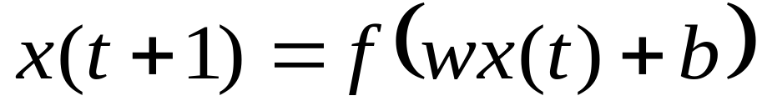
From Discrete Computing to Continuous Computing
total 55 pages

Slide 19
From Discrete Computing to Continuous Computing
total 55 pages

Slide 20
From Discrete Computing to Continuous Computing
total 55 pages

Slide 21
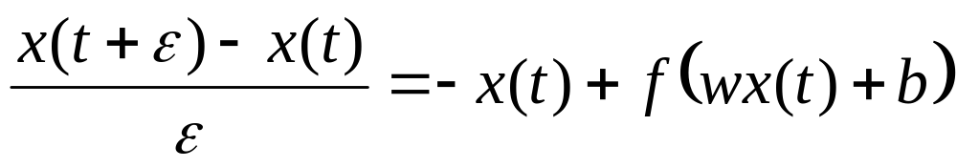
From Discrete Computing to Continuous Computing
total 55 pages

Slide 22

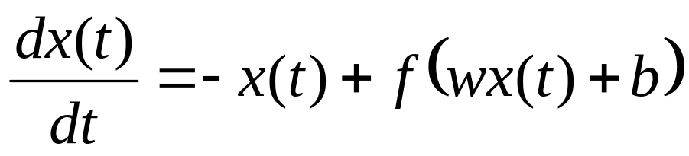
From Discrete Computing to Continuous Computing
total 55 pages

Slide 23
Continuous Computing RNNs
total 55 pages

Slide 24
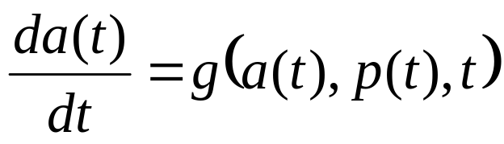
Recurrent NNs
RNN model:
Network time
Network state
Network input
total 55 pages

Slide 25
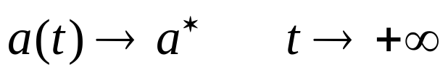
Recurrent NNs
What’s the output of a RNN?
Network time
Network state
Network input
Network output
total 55 pages

Slide 26
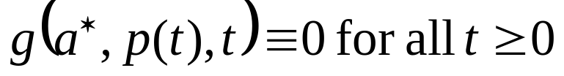
Convergence of RNNs
Network state
Converge ?
Equilibrium point:
total 55 pages

Slide 27
Trajectories
total 55 pages

Slide 28
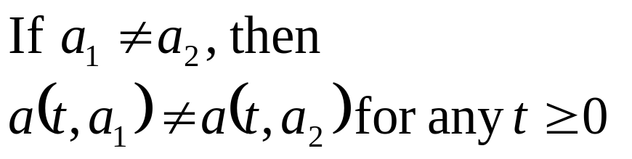
Trajectories
total 55 pages

Slide 29
Trajectories
total 55 pages

Slide 30
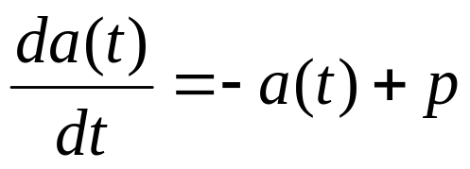
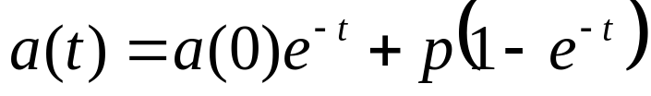
A Simple Example
a
p
t
total 55 pages

Slide 31
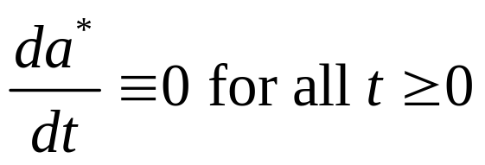
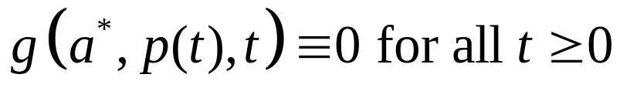
Equilibrium Points
Equilibrium point:
total 55 pages

Slide 32
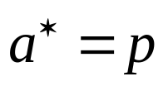
Equilibrium Points
a
p
t
total 55 pages

Slide 33
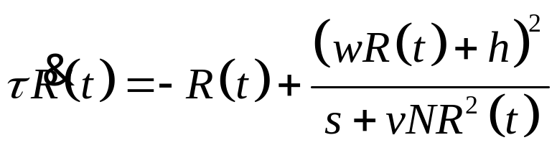
Equilibrium Points
Lei Zhang and Z. Yi, Dynamical Properties of Background Neural Networks with Uniform Firing Rate and Background Input, Chaos, Solitons and Fractals, vol. 33, pp. 979-985, 2007
total 55 pages

Slide 34
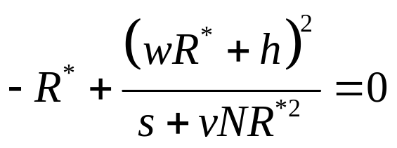
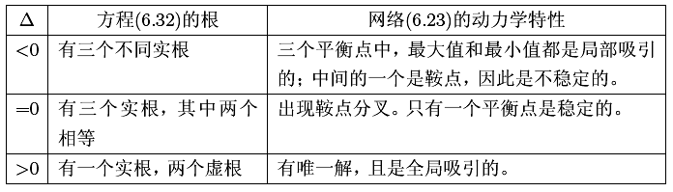
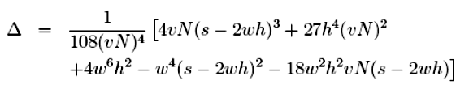
Equilibrium Points
total 55 pages

Slide 35

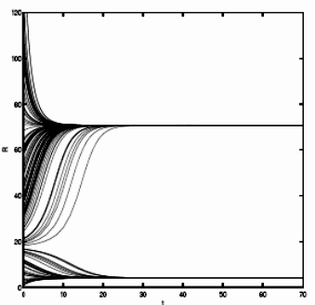

Equilibrium Points
total 55 pages

Slide 36
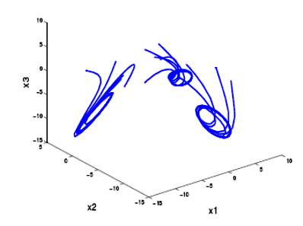
Limit Cycle
Lei Zhang, Z. Yi and J. Yu, Multiperiodicity and Attractivity of Delayed Recurrent Neural Networks with Unsaturating Piecewise Linear Transfer Functions, IEEE Transactions on Neural Networks, vol. 19, no. 1, pp. 158-167, Jan. 2008.
total 55 pages

Slide 37
Convergence of RNNs
Attractors
total 55 pages

Slide 38
Convergence of RNNs
Does each trajectory of a RNN converge to an equilibrium?
Methods: 1. Solving differential equation directly;
2. Energy method.
total 55 pages

Slide 39
Method One
Solving Differential Equations
total 55 pages

Slide 40
A Simple Example
a
p
t
total 55 pages

Slide 41
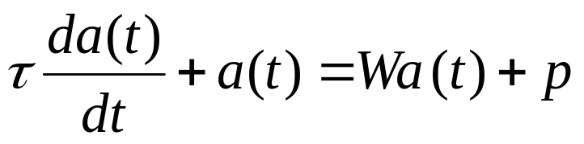
Linear RNNs
total 55 pages

Slide 42
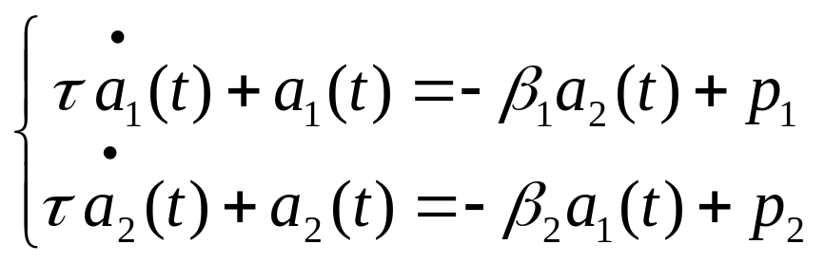
Linear RNNs
total 55 pages

Slide 43

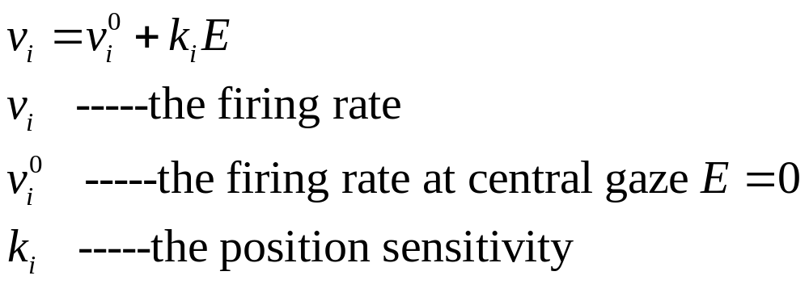
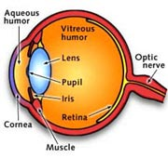
Linear RNNs
H. S. Seung, How the brain keeps the eyes still, Proc. Natl. Acad. Sci. USA, vol. 93, pp. 13339-13344, 1996
total 55 pages

Slide 44
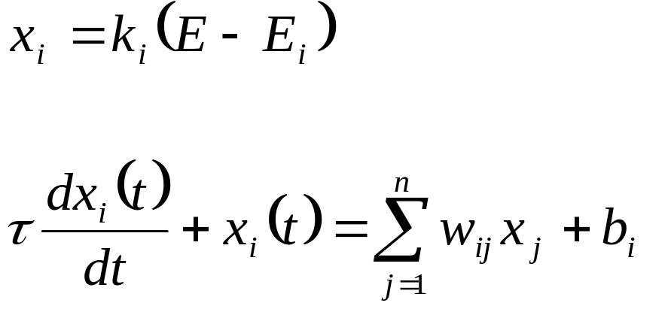
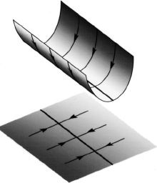
Line Attractor
Seung 1996
total 55 pages

Slide 45

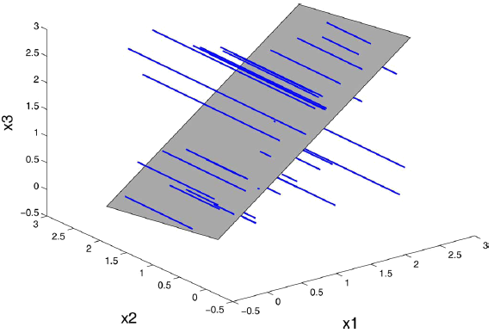
Line Attractor
J. Yu, Z. Yi and Lei Zhang, “Representations of Continuous Attractors of Recurrent Neural Networks”, IEEE Transactions on Neural Networks, vol. 20, no. 2, pp. 368-372, Feb. 2009.
total 55 pages

Slide 46
Method Two
Energy Functions Method
total 55 pages

Slide 47
Energy Function Method
Lyapunov Method
Stability theory
LaSalle Principle
Energy Function
total 55 pages

Slide 48
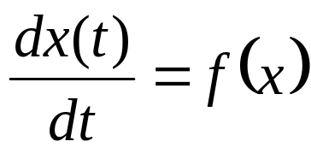
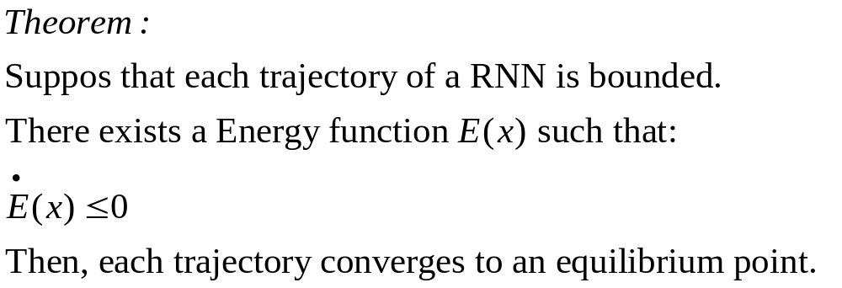
Energy Function Method
Recurrent Neural Network Model
total 55 pages

Slide 49
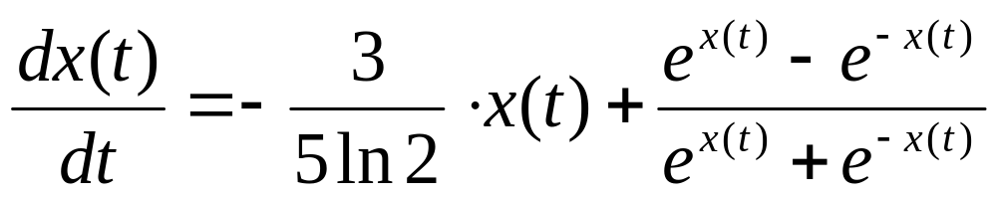
Example
total 55 pages

Slide 50
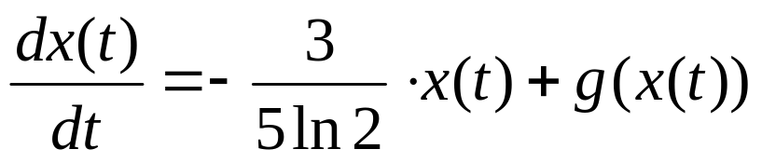
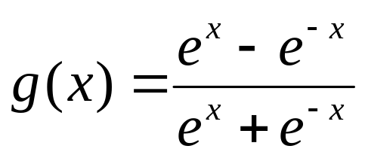
Example
Equilibrium Points: 0, ln2, -ln2
total 55 pages

Slide 51

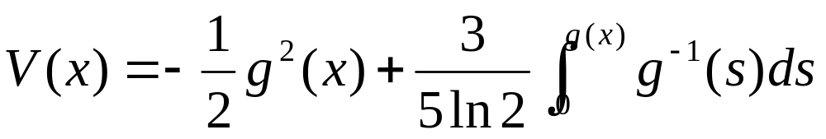
Example
total 55 pages

Slide 52
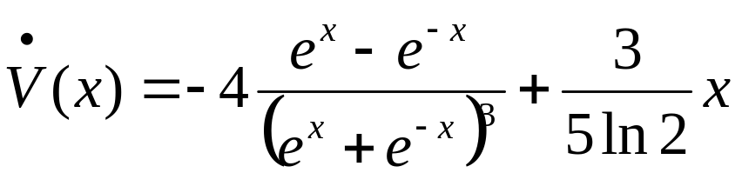
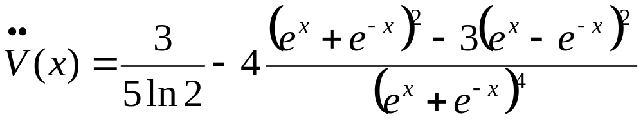
Example
total 55 pages

Slide 53
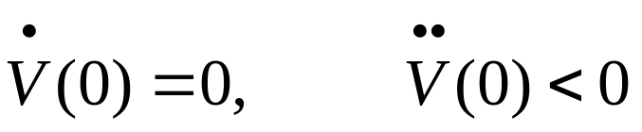

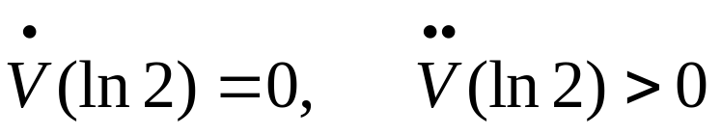
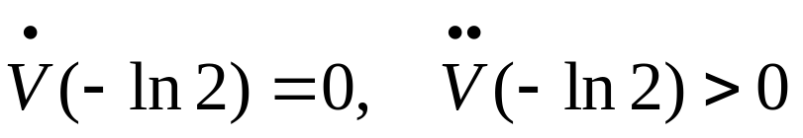




Example
Equilibrium Points: 0, ln2, -ln2
total 55 pages

Slide 54
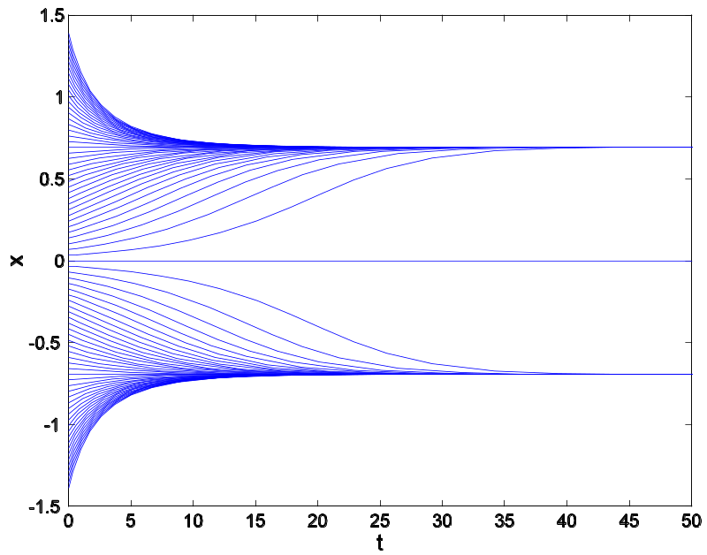
Example
ln2
0
-ln2
total 55 pages

Slide 55

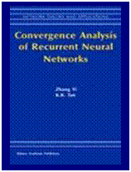
Reference Books
Zhang Yi and K. K. Tan, Convergence Analysis of Recurrent Neural Networks, Kluwer Academic Publishers, ISBN 1-4020-7694-0, 2004.
H. J. Tang, K. C. Tan and Zhang Yi, Neural Networks: Computational Models and Applications, Springer-Verlag ISBN:978-3-540-69225-6, 2007.
total 55 pages

